Slide 1
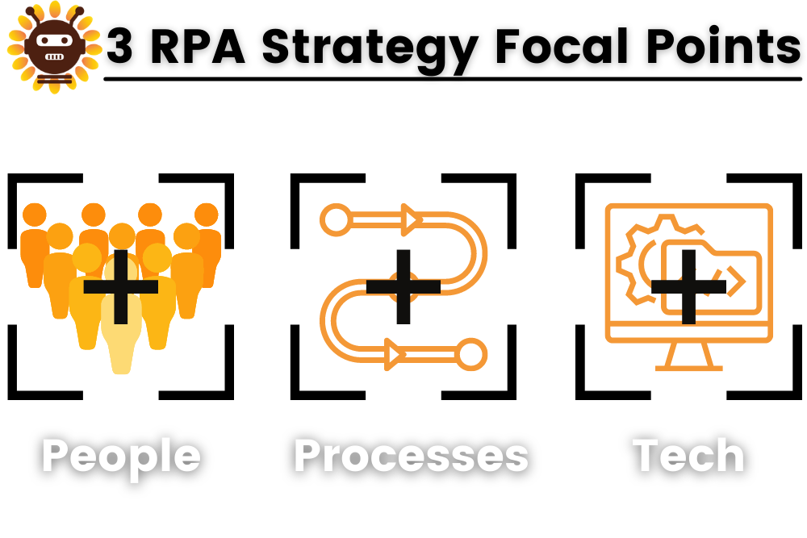
What is an RPA Strategy
An RPA strategy is a comprehensive plan for how an organization will implement RPA into its workflows. Adopting RPA without a well-intentioned plan will result in misaligned expectations, skill shortcomings, and other pitfalls that could take away from the success of our automation. Our RPA strategy should focus on 3 key elements of your business: people, processes, and technology. This will help illuminate our employee skills, our customer needs, our workflows, and our IT capabilities. Combined, these elements drive Our business outcomes.

Slide 2
4 Essential Elements of an RPA Strategy
Vision
A clear vision will lay a solid groundwork for our RPA strategy. This will help define our expectations of the robotic process automation and align them with our colleagues. “What are we trying to achieve with RPA?” - To be a Leading Intelligent Automation sevice provider including RPA implementation and RPA support.
Competence
Robotic process automation requires a certain number of skills to be successful. That is why organizations need to know the possibilities and limitations of their current competencies. An important question to ask during this phase is, “What skills are required for robotic process automation, and how can we acquire skills that are missing from our team?” - Primary Skills - Uipath, Power Automate, Automation 360, Python(to be developed).
Secondory Skills - Blueprism, SAP IRPA
COE
The organizational aspect of an RPA strategy requires leadership to delegate management of the automation. Companies can opt to manage their RPA centrally (Center of Excellence).
KPIs
Before investing in robotic process automation, executives will want to know the ROI for RPA. This is just one of the important metrics you’ll need to measure in order to determine the success of your RPA strategy. Key performance indicators (KPIs) will help answer the question, “How will the success of RPA be measured?”

Slide 3
Long-Term RPA Strategy
Adopting robotic process automation is a big step, but our RPA strategy should take us to higher heights. Our long-term RPA strategy should incorporate the ideology of digital transformation: a movement to modify existing business processes to meet the needs to today’s digital age. This concept marks the reimagining of the way we do our jobs and engage with customers. While robotic process automation is the first step in achieving digital transformation because it is a simple automation that returns positive results quickly, it is only the beginning.
In order to extend the horizons of the automation, more digital transformation technologies need to be incorporated. Intelligent process automation, or intelligent automation, or IA exists to accelerate the technology transformation journey. Intelligent automation is the combination of RPA with advanced technologies such as artificial intelligence (AI), optical character recognition (OCR), cognitive technologies, computer vision, etc. With the help of intelligent automations and use of analytics, we can have solutions with automated decisions providing more flexibility to the end-to-end automation.

Slide 4
8 parts of a long-term RPA strategy
1. Discovery: Assess organizational fit, appetite, and readiness for RPA and research available RPA tools and begin to sketch a vision for organizational transformation.
2. Readiness: Choose your RPA sponsor and project lead to champion the rollout and coordinate across diverse teams, identify business processes to first automate, and define success criteria.
3. RPA vendor engagement: Select the right vendor for our needs, based on long-term goals, user experience, security, and scalability.
4. Proof of concept: Put RPA to the test for our unique business context and needs – a PoC will put our business-case assumptions to the test and validate our implementation model.
5. RPA pilot: This is where businesses put an automated process into everyday operation and evaluate impact based on the predefined success criteria.
6. RPA center of excellence: Establish a hub for RPA implementation and adoption, concentrating expertise to all business functions along with a fine-tuned development environment, to help scale RPA across our organization.
7. Expansion: The CoE will communicate RPA implementation successes and goals, optimize the digital workforce, and identify additional processes for automation. Preconfigured bots and digital workers can help rapid scaling.
8. Digital transformation: RPA becomes part of our organizational DNA, as automating increasingly complex processes changes the nature of work for our people and business.

Slide 5
Area to be focused more
1. Upgrade Uipath partnership
2. Promoting RPA
3. Good Skill Set
4. Find Opportunities from Existing and new clients
5. Setup COE

